Slide 1
UNIT-II
AC CIRCUITS

Slide 2
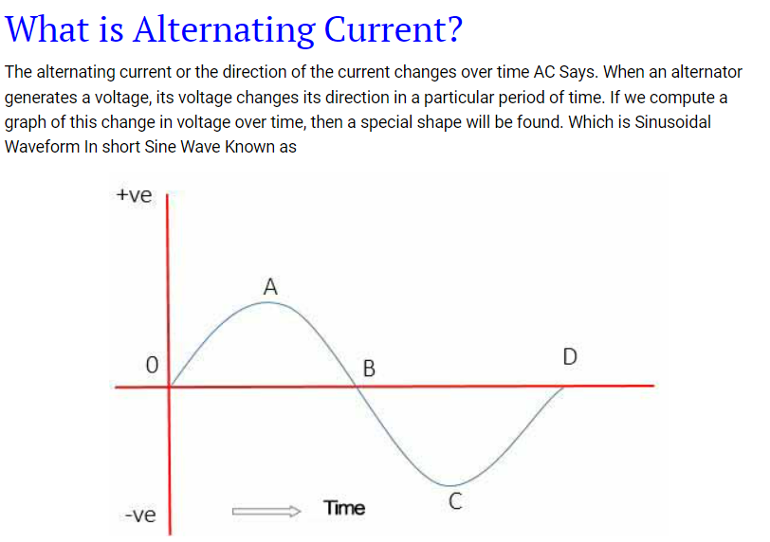
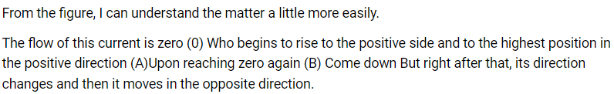

Slide 3
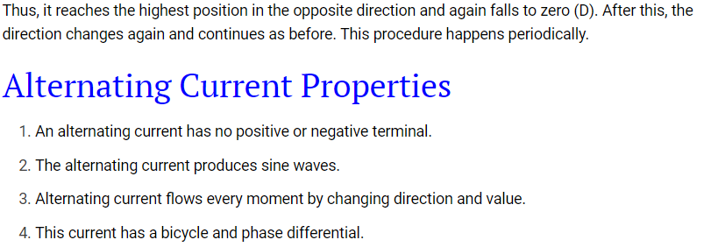
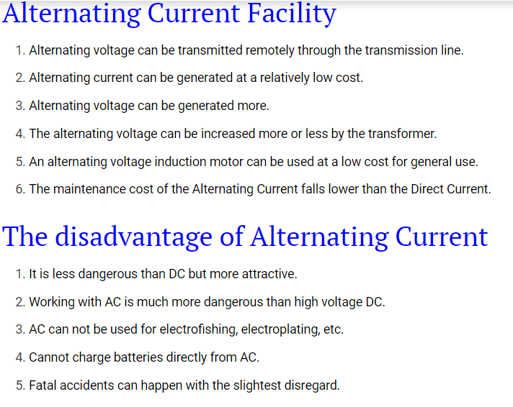

Slide 4


Slide 5
Advantages of ac over dc:
We all know that we got ac supply in our homes and we got this supply by transmitting ac over long distances. AC can be transmitted using step up transformers but direct current or dc can not be transmitted by this method.
The ac is easy to generate than dc.
It is cheaper to generate ac than dc.
The ac generators have higher efficiency than dc.
The loss of energy during transmission is negligible for ac.
The ac can be easily converted into dc.
The variation of ac can easily be done using transformers either step up or step down.
The value or magnitude of ac can be decreased easily without loss of excess of energy. This can be done by using choke coil.

Slide 6
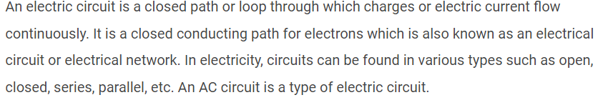
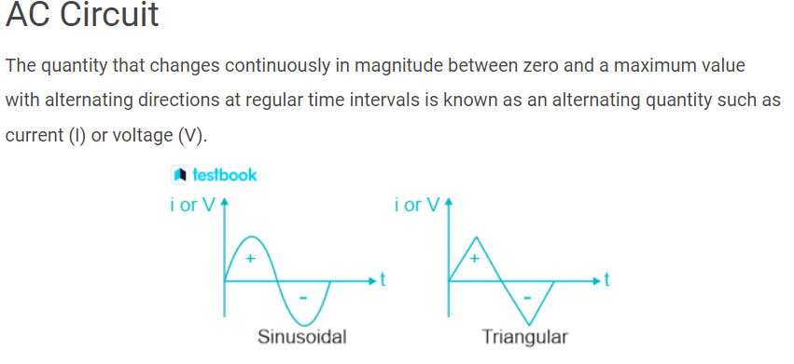
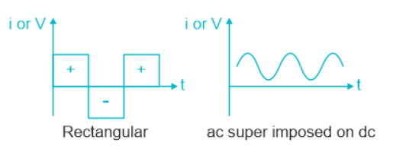

Slide 7
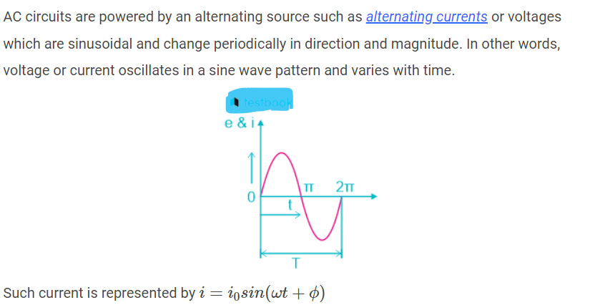


Slide 8
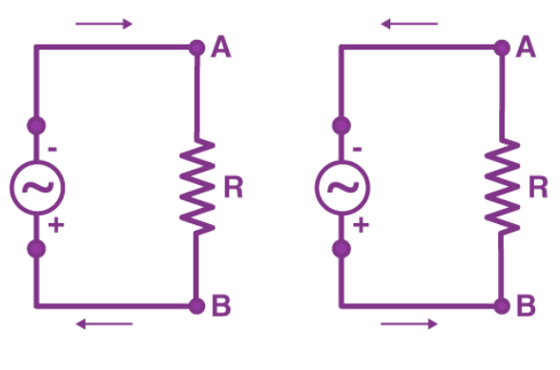
AC Circuit
Direct current (DC) and alternating current (AC) are the two types of electricity. DC circuit and AC circuit show the structure of the respective circuit systems.
The main components of AC circuits are resistors, capacitors, and inductors.
All these passive electrical elements have one property in common; they restrict electric current in a circuit coil but in completely different ways.

Slide 9
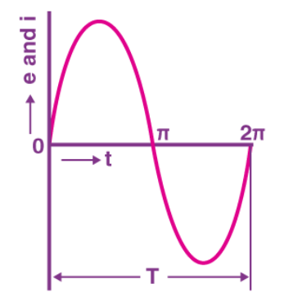
The voltages and currents are marked by direction and magnitude in an AC circuit.
The alternating values may or may not be in phase with each other, relying on the different variables of the system like capacitance, inductance and resistance.
The sinusoidal alternating values are current and voltage, which differ by cohering to the sine of angle θ.
AC Current
An alternating current (AC) is an electrical current that regularly reverses direction and changes its value constantly with time, contrary to DC current, which travels only in a single direction.
For many decades of electric power, the sinusoidal current and voltage have been used in power businesses and homes.

Slide 10
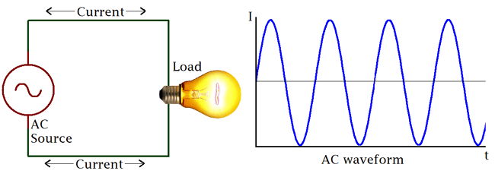

Slide 11
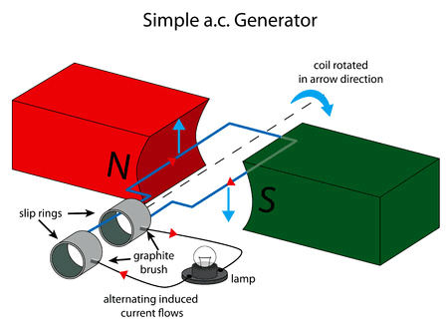
Basic AC Source (Single Coil AC Generator)
The principle around AC generation is simple. If a magnetic field or magnet is rotated along a stationary set of coils (wires) or the rotation of a coil around a stationary magnetic field, an Alternating current is generated using an AC generator(Alternator).
The simplest form of AC generator consists of a loop of wire that is mechanically rotated about an axis while positioned between the north and south poles of a magnet.
Consider the Image below.

Slide 12
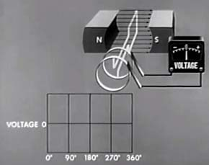
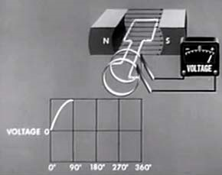
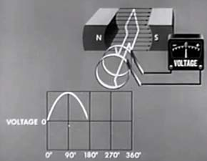
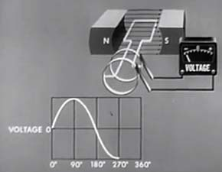
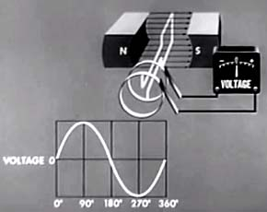

Slide 13
From the images shown above, we can deduce that, certain number of magnetic field lines will be cut as the armature rotates, the amount of ‘lines cut’ determines the voltage output.
With each change in the angle of rotation and the resultant circular motion of the armature against the magnetic lines, the amount of ‘magnetic lines cut’ also changes, hence the output voltage also change.
For instance, the magnetic field lines cut at zero degree is zero which makes the resultant voltage zero, but at 90 degrees, almost all the magnetic field lines are cut, thus maximum voltage in one direction is generated in one direction.
The same holds at 270 degrees only that it’s generated in the opposite direction. There is thus a resultant change in the voltage as the armature rotates within the magnetic field leading to the formation of a sinusoidal waveform.
The resultant induced voltage is thus sinusoidal, with an angular frequency ω measured in radians per seconds.
The Induced current in the setup above is giving by the equation:
I = V/R
Where V= NABwsin(wt)
Where N = Speed
A = Area
B = Magnetic field
w = Angular frequency.

Slide 14
Real AC generators are obviously more complex than this but they work based on the same principles and laws of electromagnetic induction as described above.
Alternating current is also generated using certain kind of transducers and oscillator circuits as found in inverters.

Slide 15
Various Terms Used in AC Circuits
Amplitude
Alternation
Cycle
Instantaneous Value
Frequency
Time Period
Wave Form

Slide 16
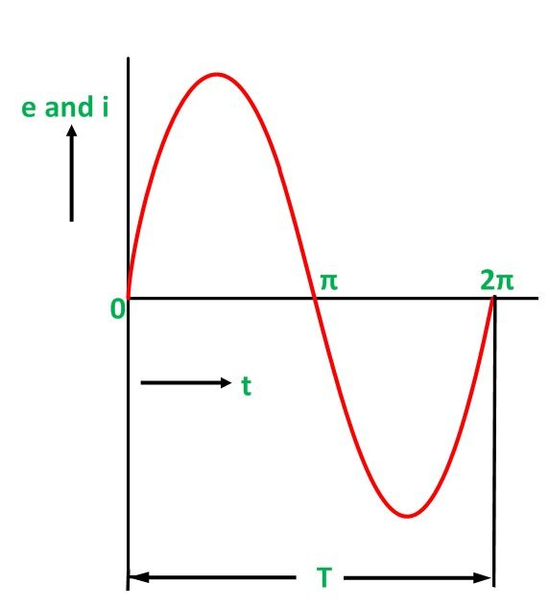
The waveform of the alternating voltage with respect to the time and the current flowing through the resistance (R) in the circuit is shown below.
The various terms which are frequently used in an AC circuit are as follow
1. Amplitude
The maximum positive or negative value attained by an alternating quantity in one complete cycle is called Amplitude or peak value or maximum value. The maximum value of voltage and current is represented by E_{m} or V_{m} and I_{m} respectively.
2.Alternation
One-half cycle is termed as alternation. An alternation span is of 180 degrees electrical.

Slide 17
Cycle
When one set of positive and negative values completes by an alternating quantity or it goes through 360 degrees electrical, it is said to have one complete Cycle.
Instantaneous Value
The value of voltage or current at any instant of time is called an instantaneous value. It is denoted by (i or e).
Frequency
The number of cycles made per second by an alternating quantity is called frequency. It is measured in cycle per second (c/s) or hertz (Hz) and is denoted by (f).
Time Period
The time taken in seconds by a voltage or a current to complete one cycle is called Time Period. It is denoted by (T).
Wave Form
The shape obtained by plotting the instantaneous values of an alternating quantity such as voltage and current along the y-axis and the time (t) or angle (θ=wt) along the x-axis is called a waveform.

Slide 18
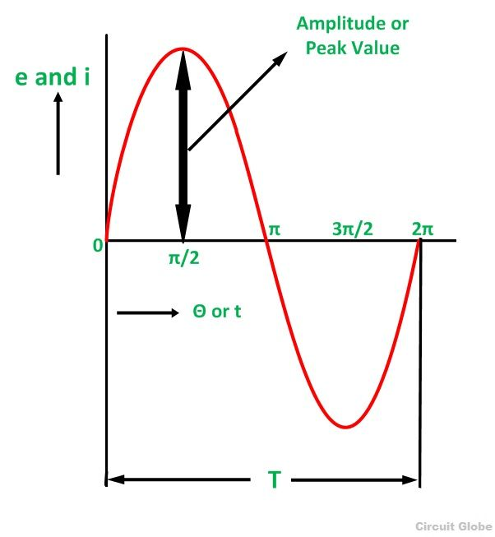
Peak Value
Definition: The maximum value attained by an alternating quantity during one cycle is called its Peak value.
It is also known as the maximum value or amplitude or crest value.
The sinusoidal alternating quantity obtains its peak value at 90 degrees as shown in the figure here
The peak values of alternating voltage and current is represented by E_{m} and I_{m} respectively.

Slide 19
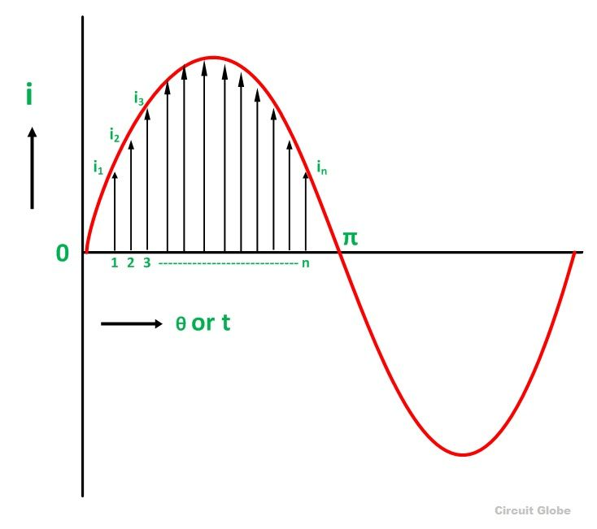
Average Value
Definition: The average of all the instantaneous values of an alternating voltage and currents over one complete cycle is called Average Value.
If we consider symmetrical waves like sinusoidal current or voltage waveform, the positive half cycle will be exactly equal to the negative half cycle. Therefore, the average value over a complete cycle will be zero.
The work is done by both, positive and negative cycle and hence the average value is determined without considering the signs.
So, the only positive half cycle is considered to determine the average value of alternating quantities of sinusoidal waves. Let us take an example to understand it.
Divide the positive half cycle into (n) number of equal parts as shown in the above figure
Let i₁, i₂, i₃…….. i_{n} be the mid ordinates
The Average value of current I_{av} = mean of the mid ordinates

Slide 20
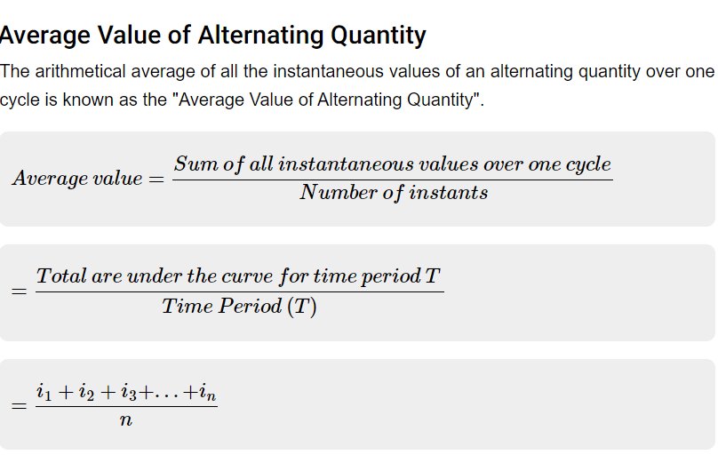

Slide 21
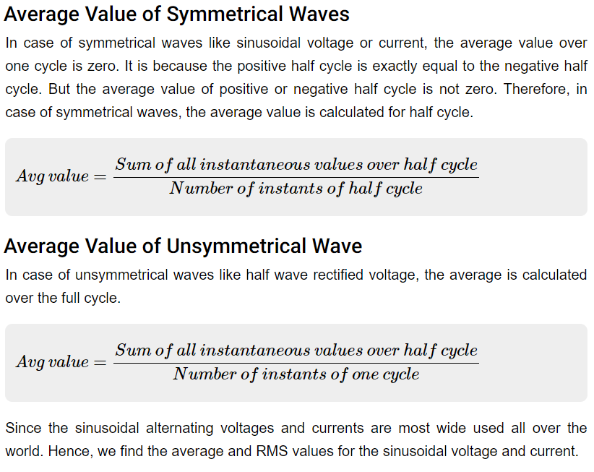

Slide 22
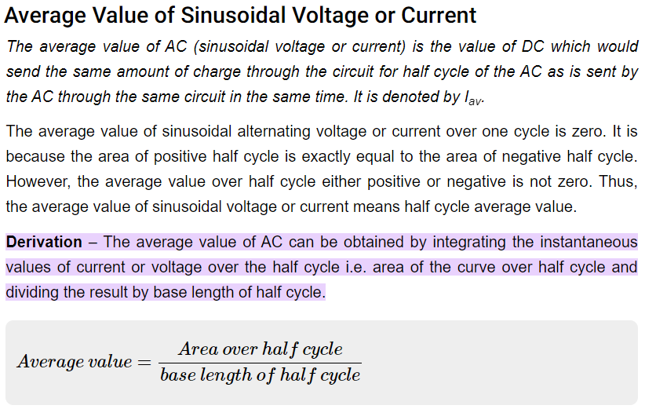

Slide 23
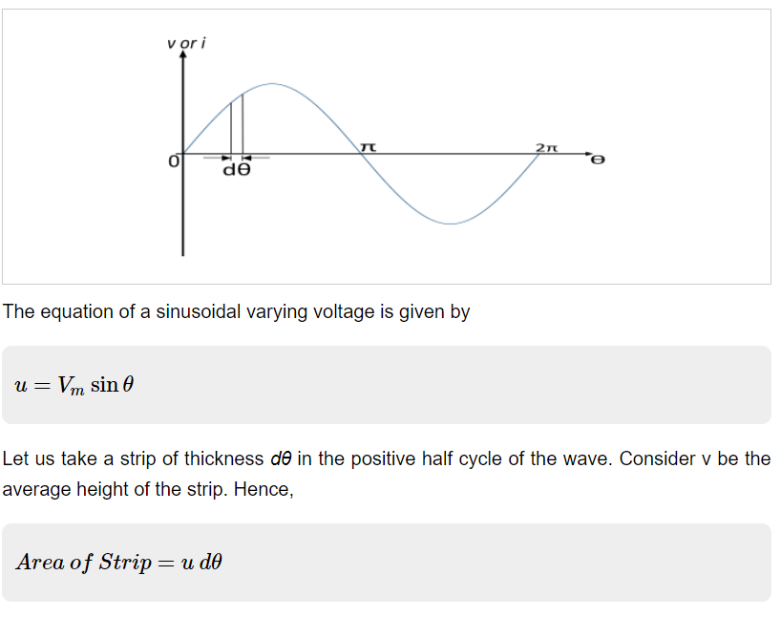

Slide 24
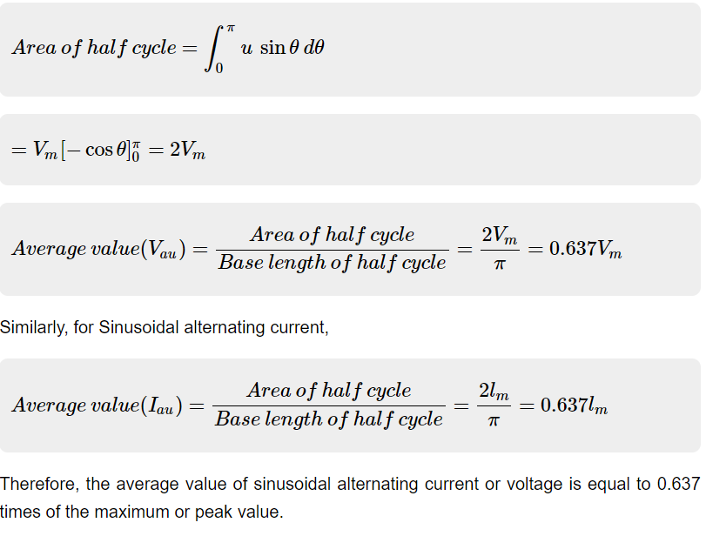

Slide 25
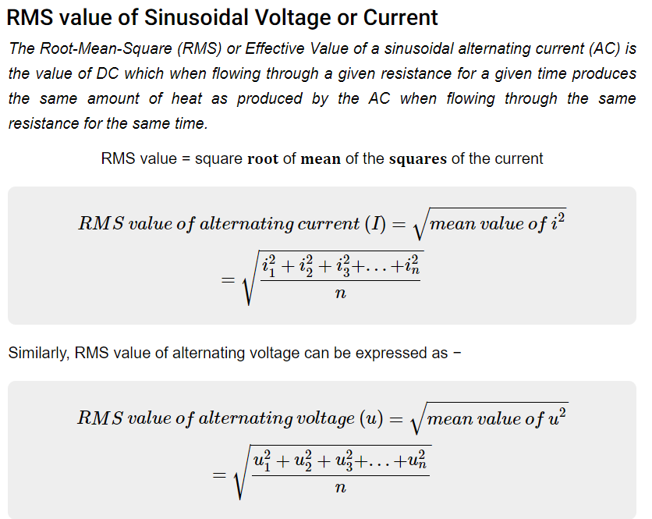

Slide 26
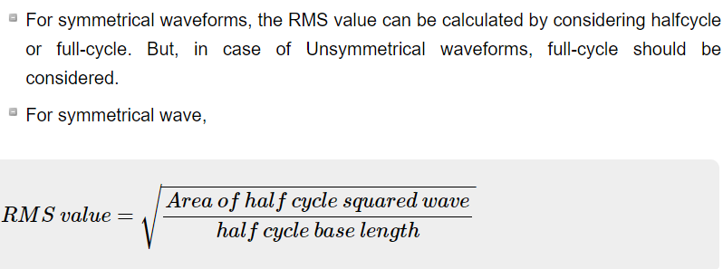

Slide 27
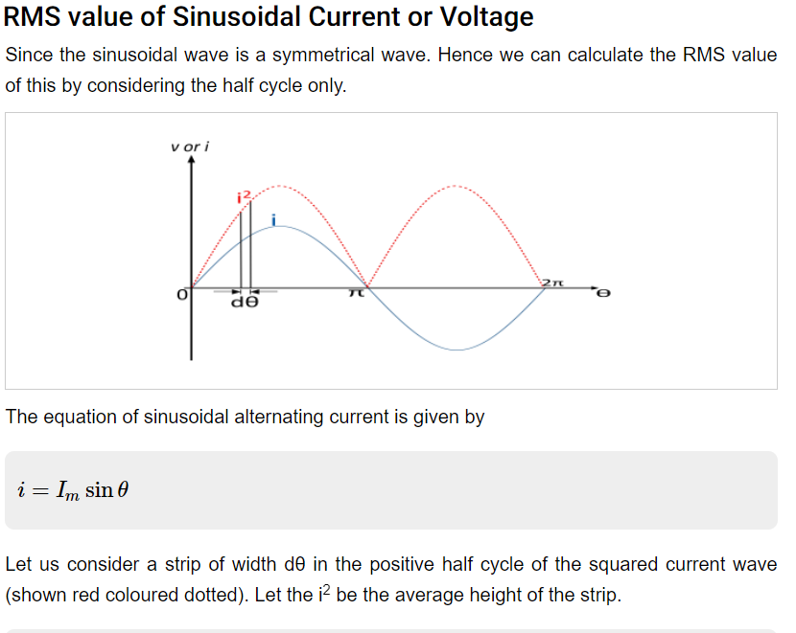

Slide 28
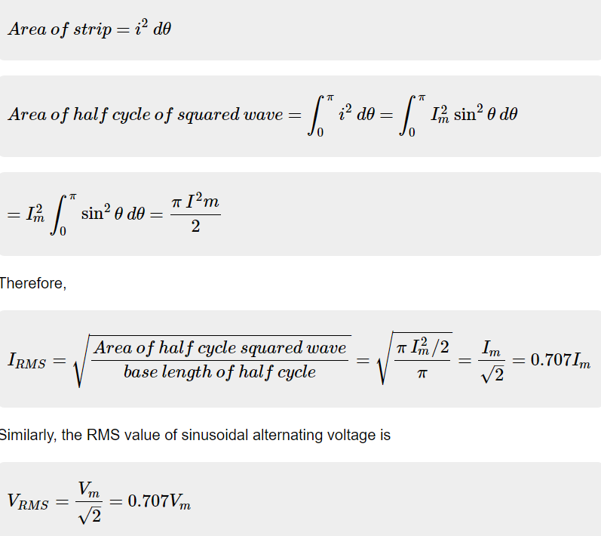

Slide 29
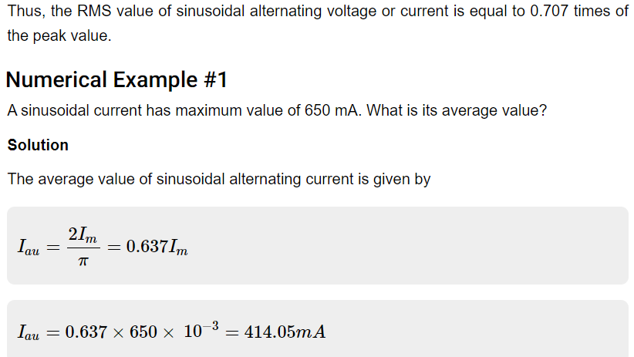

Slide 30
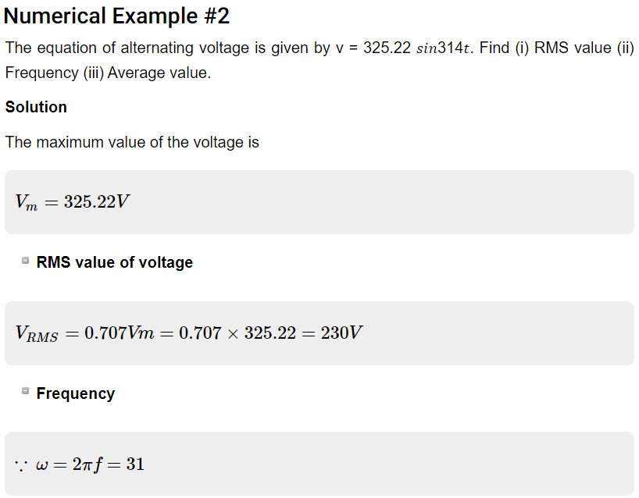

Slide 31
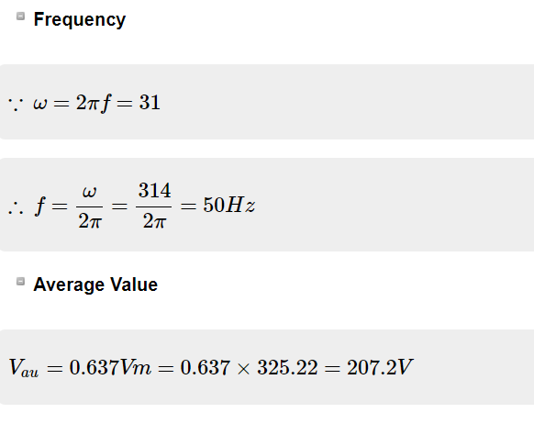

Slide 32
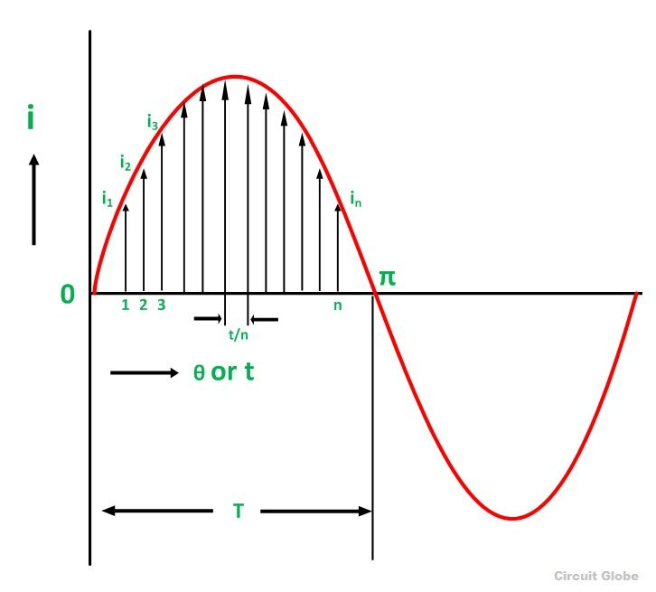
(OR)
R.M.S Value
Definition: That steady current which, when flows through a resistor of known resistance for a given period of time than as a result the same quantity of heat is produced by the alternating current when flows through the same resistor for the same period of time is called R.M.S or effective value of the alternating current.
In other words, the R.M.S value is defined as the square root of means of squares of instantaneous values.
Let I be the alternating current flowing through a resistor R for time t seconds, which produces the same amount of heat as produced by the direct current (I_{eff}).
The base of one alteration is divided into n equal parts so that each interval is of t/n seconds as shown in the figure below.
Let i₁, i₂, i₃,………..in be the mid ordinates
Then the heat produced in

Slide 33
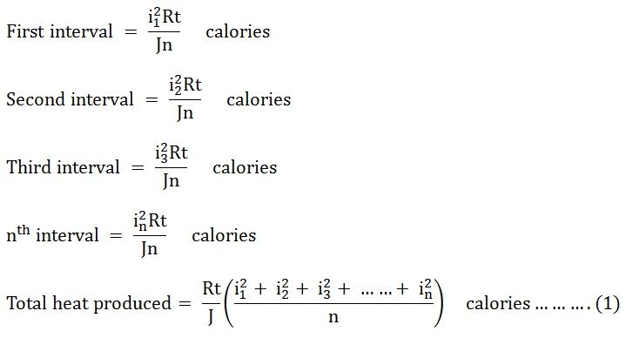
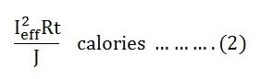
Since It is considered as the effective value of this current, then the total heat produced by this current will be

Slide 34
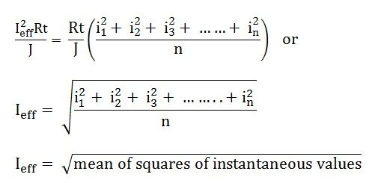
Now, equating equation (1) and (2) we will get
I_{eff} = square root of mean of squares of instantaneous values = R.M.S value
Root Mean Square is the actual value of an alternating quantity which tells us an energy transfer capability of an AC source.
The ammeter records the RMS value of alternating current and voltmeter record’s the root mean square (R.M.S) value of alternating voltage. The domestic single-phase AC supply is 230 V, 50 hertz, where 230 V is the R.M.S value of alternating voltage.

Slide 35
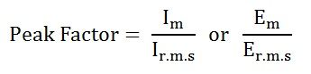
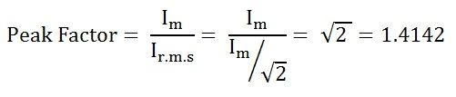
Peak Factor
Definition: Peak Factor is defined as the ratio of maximum value to the R.M.S value of an alternating quantity. The alternating quantities can be voltage or current. The maximum value is the peak value or the crest value or the amplitude of the voltage or current.
where,
I_{m} and E_{m} are the maximum value of the current and the voltage respectively, and I_{r.m.s} and E_{r.m.s} are the roots mean square value of the alternating current and the voltage respectively.
For the current varying sinusoidally, the peak factor is given as:
The value of Peak Factor is 1.4142

Slide 36
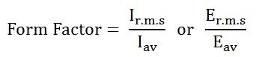
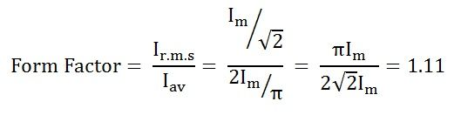
Form Factor
Definition: The ratio of the root mean square value to the average value of an alternating quantity (current or voltage) is called Form Factor. The average of all the instantaneous values of current and voltage over one complete cycle is known as the average value of the alternating quantities.
I_{r.m.s} and E_{r.m.s} are the roots mean square values of the current and the voltage respectively, and I_{av} and E_{av} are the average values of the alternating current and the voltage respectively.
For the current varying sinusoidally, the Form Factor is given as:
The value of Form Factor is 1.11

Slide 37
There is a relation between the peak value, the average value, and the root means square (R.M.S) value of an alternating quantity.
Therefore, to express the relationship between all these three quantities, the two factors are used, namely as Peak Factor and Form Factor.
The Form Factor for the various sinusoidal waveforms are as follows:
For a sine wave, it is π/2√2 = 1.11072073
For a half-wave rectified sine wave, it is π/2 = 1.5707963
For a full-wave rectified sine wave, it is π/2√2 = 1.11072073
For a square wave, it is equal to 1
For triangle waveform, it is 2/√3 = 1.15470054
For sawtooth waveform, it is 2/√3 = 1.15470054
This is all about the form factor.

Slide 38
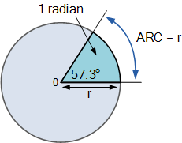
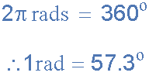
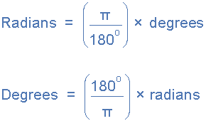
Definition of a Radian
Relationship between Degrees and Radians

Slide 39

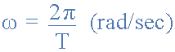
Angular Velocity of a Sinusoidal Waveform
and in the India, the angular velocity or frequency of the mains supply is given as:
As frequency is inversely proportional to its time period, ƒ = 1/T we can therefore substitute the frequency quantity in the above equation for the equivalent periodic time quantity and substituting gives us.

Slide 40
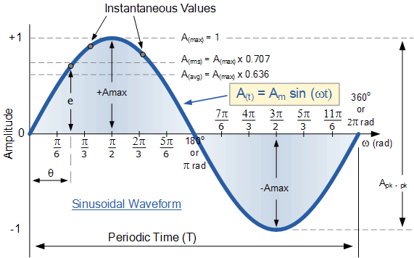
A Sinusoidal Waveform

Slide 41
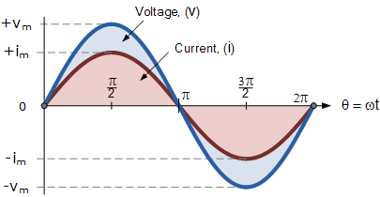
Phase Difference and Phase Shift
Phase Difference is used to describe the difference in degrees or radians when two or more alternating quantities reach their maximum or zero values

Slide 42

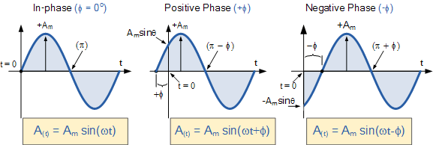
Phase Difference Equation
Phase Relationship of a Sinusoidal Waveform

Slide 43

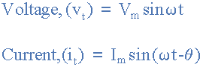
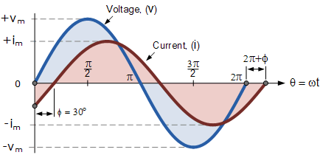
Two Sinusoidal Waveforms – “in-phase”
Phase Difference of a Sinusoidal Waveform

Slide 45
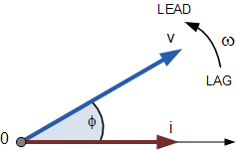
Phasor Diagrams and Phasor Algebra
Phasor Diagrams are a graphical way of representing the magnitude and directional relationship between two or more alternating quantities
Basically a rotating vector, simply called a “Phasor” is a scaled line whose length represents an AC quantity that has both magnitude (“peak amplitude”) and direction (“phase”) which is “frozen” at some point in time.
A phasor is a vector that has an arrow head at one end which signifies partly the maximum value of the vector quantity ( V or I ) and partly the end of the vector that rotates.
Generally, vectors are assumed to pivot at one end around a fixed zero point known as the “point of origin” while the arrowed end representing the quantity, freely rotates in an anti-clockwise direction at an angular velocity, ( ω ) of one full revolution for every cycle. This anti-clockwise rotation of the vector is considered to be a positive rotation. Likewise, a clockwise rotation is considered to be a negative rotation.

Slide 46



Phase Difference of a Sinusoidal Waveform
Phasor Diagram of a Sinusoidal Waveform

Slide 47

Complex Numbers and Phasors
The mathematics used in Electrical Engineering to add together resistances, currents or DC voltages use what are called “real numbers” used as either integers or as fractions.

Slide 48

Phasor Addition of two Phasors
V T=V1^2+V2^2+V1V2COS o

Slide 49

Difference Between Resistance and Impedance are given below in the tabulated form.

Slide 50


Slide 51

Analysis of AC circuits with single basic network elements.
Pure Resistive AC Circuit
The circuit containing only a pure resistance of R ohms in the AC circuit is known as Pure Resistive AC Circuit. Hence, the alternating current and voltage follows a shape of the Sine wave or known as the sinusoidal waveform.
In the purely resistive circuit, the power is dissipated by the resistors and the phase of the voltage and current remains same i.e., both the voltage and current reach their maximum value at the same time. The resistor is the passive device which neither produce nor consume electric power. It converts the electrical energy into heat.
In an AC circuit, the ratio of voltage to current depends upon the supply frequency, phase angle, and phase difference. In an AC resistive circuit, the value of resistance of the resistor will be same irrespective of the supply frequency.
Let the alternating voltage applied across the circuit be given by the equation

Slide 52



The value of current will be maximum when ωt= 90° or sinωt = 1
Phase Angle and Waveform of Resistive Circuit
From equation (1) and (3), it is clear that there is no phase difference between the applied voltage and the current flowing through a purely resistive circuit, i.e. phase angle between voltage and current is zero.
Hence, in an AC circuit containing pure resistance, the current is in phase with the voltage as shown in the waveform figure below.

Slide 53


Slide 54



The instantaneous power in a purely resistive circuit is given by the equation shown below: Instantaneous power, p= vi
The average power consumed in the circuit over a complete cycle is given by
As the valve of cosωt is zero.
So, putting the value of cosωt in equation (4) the value of power will be given by

Slide 55

Where,
P – average power
V_{r.m.s} – root mean square value of supply voltage
I_{r.m.s} – root mean square value of the current
Hence, the power in a purely resistive circuit is given by:
The voltage and the current in the purely resistive circuit are in phase with each other having no phase difference with phase angle zero. The alternating quantity reaches their peak value at the interval of the same time period that is the rise and fall of the voltage and current occurs at the same time.

Slide 56

Purely Resistive | Inductive | Capacitive Circuit
All AC circuits are made up of the combination of resistance R, inductance L and capacitance C. The circuit elements R, L, and C are known as circuit parameters. To study a general AC circuit it is necessary to consider the effect of each parameter separately.
purely resistive circuit:
A purely resistive circuit is a circuit which has inductance so small that at normal frequency its reactance is negligible as compared to its resistance. In a purely resistive circuit whole of the applied voltage is utilized in overcoming the ohmic resistance of the circuit. A purely resistive circuit is also known as the non-inductive circuit.

Slide 57

From the expression of instantaneous applied voltage and instantaneous current it is evident that in a purely resistive circuit, the applied voltage and current are in phase with each other.

Slide 58
It is seen from the power curve for purely resistive circuit no part of power cycle becomes negative at any time i.e. in the purely resistive circuit power is never zero. This is so because instantaneous values of voltage and current are always either positive or negative and hence the product is always positive. The frequency of power cycle is double that of the voltage and current waves. The power factor of the purely resistive circuit (cos φ) is 1.
Pure Inductive Coil
A pure inductive coil is that which has no ohmic resistance and hence no I²R loss. A pure inductance is practically not attainable, though it is nearly approached by a coil wound with such thick wire that its resistance is negligible.
Whenever an alternating voltage is applied to a purely inductive circuit a back EMF is produced due to self-inductance of the coil. The back EMF, at every step, opposes the rise or fall of current through the coil. As there is no ohmic voltage drop, the applied voltage has to overcome this self-induced EMF only.

Slide 59

From the expression of instantaneous applied voltage and instantaneous current flowing through the purely inductive circuit, it is observed that the current lags behind the voltage by π/2.

Slide 60


Slide 61
The power curve for the purely inductive circuit is shown in the figure.
It is clear that average power in a half cycle is zero as the negative and positive loop area under power curve is the same.
In a purely inductive circuit, during the first quarter cycle, what so ever energy (or power) is supplied by the source that is stored in the magnetic field set-up around the coil.
In the next quarter cycle, the magnetic field collapses and the energy (or power) stored in the magnetic field is returned to the source.
Hence, no power is consumed in a purely inductive circuit.

Slide 62
Inductive Reactance
The opposition offered to the flow of an alternating current by the inductance of the circuit is known as inductive reactance. In fact, it is a property of all inductors. It is denoted by X_{L}. X_{L}=ωL=2πfLohms
where,
f=frequency in Hz;
L=inductance in henrys.
The unit of inductive reactance is ohm. The inductive reactance of a given inductor is directly proportional to the frequency of applied voltage. It means inductive reactance increases linearly with frequency.

Slide 63

Purely Capacitive Circuit
When an alternating voltage is applied to a purely capacitive circuit, the capacitor is charged first in one direction and then in the opposite direction
.

Slide 64

From the expression of instantaneous applied voltage and instantaneous current flowing through the purely capacitive circuit, it is observed that the current leads the voltage by π/2.

Slide 65
The power curve for the purely capacitive circuit is shown in the figure.
It is clear that average power in a half cycle is zero as the negative and positive loop area under power curve is the same. In the purely capacitive circuit, during the first quarter cycle, what so ever energy (or power) is supplied by the source is stored in the electric field set-up between the capacitor plates.
In the next quarter cycle, the electric field collapses and the energy (or power) stored in the electric field is returned to the source.
This process is repeated in every alternation. Hence, no power is consumed in the purely capacitive circuit.

Slide 66
Capacitive Reactance
Capacitive reactance is the opposition offered to the flow of alternating current by the capacitance of a capacitor. In fact, it is a property of all the capacitors. It is denoted by X_{C}. X_{C}=1/ωC=1/2πfCohms
where,
f=frequency in Hz;
C=capacitance in farad.
The unit of capacitive reactance is ohm.

Slide 67

RL Series Circuit
A circuit that contains a pure resistance R ohms connected in series with a coil having a pure inductance of L (Henry) is known as RL Series Circuit. When an AC supply voltage V is applied, the current, I flows in the circuit.
So, I_{R} and I_{L} will be the current flowing in the resistor and inductor respectively, but the amount of current flowing through both the elements will be same as they are connected in series with each other. The circuit diagram of RL Series Circuit is shown below:
Where,
V_{R} – voltage across the resistor R
V_{L} – voltage across the inductor L
V – Total voltage of the circuit

Slide 68

Phasor Diagram of the RL Series Circuit
The phasor diagram of the RL Series circuit is shown below:
Steps to draw the Phasor Diagram of RL Series Circuit
The following steps are given below which are followed to draw the phasor diagram step by step:
Current I is taken as a reference.
The Voltage drop across the resistance V_{R} = I_{R} is drawn in phase with the current I.
The voltage drop across the inductive reactance V_{L} =IX_{L} is drawn ahead of the current I. As the current lags voltage by an angle of 90 degrees in the pure Inductive circuit.
The vector sum of the two voltages drops V_{R} and V_{L} is equal to the applied voltage V.
Now,
In right-angle triangle OAB
V_{R} = I_{R} and V_{L} = IX_{L} where X_{L} = 2πfL

Slide 69



Where,
Z is the total opposition offered to the flow of alternating current by an RL
Series circuit and is called impedance of the circuit. It is measured in ohms (Ω).
Phase Angle
In RL Series circuit the current lags the voltage by 90 degrees angle known as phase angle. It is given by the equation:

Slide 70



Power in R L Series Circuit
If the alternating voltage applied across the circuit is given by the equation:
The equation of current I is given as:
Then the instantaneous power is given by the equation:
Putting the value of v and i from the equation (1) and (2) in the equation (3) we will get

Slide 71


The average power consumed in the circuit over one complete cycle is given by the equation shown below:

Slide 72


Where cosϕ is called the power factor of the circuit.
The power factor is defined as the ratio of resistance to the impedance of an AC Circuit.
Putting the value of V and cosϕ from the equation (4) the value of power will be:
From equation (5) it can be concluded that the inductor does not consume any power in the circuit.

Slide 73

Waveform and Power Curve of the RL Series Circuit
The waveform and power curve of the RL series circuit is shown below:
The various points on the power curve are obtained by the product of voltage and current.
If you analyze the curve carefully, it is seen that the power is negative between angle 0 and ϕ and between 180 degrees and (180 + ϕ) and during the rest of the cycle the power is positive. The current lags the voltage and thus they are not in phase with each other.

Slide 74

RC Series Circuit
A circuit that contains pure resistance R ohms connected in series with a pure capacitor of capacitance C farads is known as RC Series Circuit. A sinusoidal voltage is applied and current I flows through the resistance (R) and the capacitance (C) of the circuit.
The RC Series circuit is shown in the figure below:
Where,
V_{R} – voltage across the resistance R
V_{C} – voltage across capacitor C
V – total voltage across the RC Series circuit

Slide 75
Contents:
Phasor Diagram of RC Series Circuit
Steps to draw a Phasor Diagram
Phase angle
Power in RC Series Circuit
Waveform and Power Curve of the RC Series Circuit

Slide 76

Phasor Diagram of RC Series Circuit
The phasor diagram of the RC series circuit is shown below:
Steps to draw a Phasor Diagram
The following steps are used to draw the phasor diagram of RC Series circuit
Take the current I (r.m.s value) as a reference vector
Voltage drop in resistance VR = IR is taken in phase with the current vector
Voltage drop in capacitive reactance VC = IXC is drawn 90 degrees behind the current vector, as current leads voltage by 90 degrees (in the pure capacitive circuit)
The vector sum of the two voltage drops is equal to the applied voltage
V (r.m.s value).
Now,
V_{R} = I_{R} and V_{C} = IX_{C}
Where X_{C} = I/2πfC

Slide 77


In right triangle OAB,
Where,
Z is the total opposition offered to the flow of alternating current by an RC series circuit and is called impedance of the circuit. It is measured in ohms (Ω).

Slide 78



Phase angle
From the phasor diagram shown above, it is clear that the current in the circuit leads the applied voltage by an angle ϕ and this angle is called the phase angle.
Power in RC Series Circuit
If the alternating voltage applied across the circuit is given by the equation
Then,

Slide 79


Therefore, the instantaneous power is given by p = vi
Putting the value of v and i from the equation (1) and (2) in p = vi
The average power consumed in the circuit over a complete cycle is given by:

Slide 80


Where cosϕ is called the power factor of the circuit.
Putting the value of V and cosϕ from the equation (3) the value of power will be
From the equation (4) it is clear that the power is actually consumed by the resistance only and the capacitor does not consume any power in the circuit.

Slide 81

Waveform and Power Curve of the RC Series Circuit
The waveform and power curve of the RC circuit is shown below:
The various points on the power curve are obtained from the product of the instantaneous value of voltage and current.
The power is negative between the angle (180° – ϕ) and 180° and
between (360° -ϕ) and 360° and in the rest of the cycle, the power is
positive.
Since the area under the positive loops is greater than that under the
negative loops, therefore the net power over a complete cycle is
positive.

Slide 82
RLC Series Circuit
When a pure resistance of R ohms, a pure inductance of L Henry and a pure capacitance of C farads are connected together in series combination with each other then RLC Series Circuit is formed.
aAs all the three elements are connected in series so, the current flowing through each element of the circuit will be the same as the total current I flowing in the circuit.
Contents:
RLC Circuit
Phasor Diagram of RLC Series Circuit
Steps to draw the Phasor Diagram of the RLC Series Circuit
Phase Angle
Power in RLC Series Circuit
Impedance Triangle of RLC Series Circuit

Slide 83

The RLC Circuit is shown below:
In the RLC Series circuit
X_{L} = 2πfL and X_{C} = 1/2πfC
When the AC voltage is applied through the RLC Series circuit the resulting current I flows through the circuit, and thus the voltage across each element will be:

Slide 84
V_{R} = IR that is the voltage across the resistance R and is in phase with the current I.
V_{L} = IX_{L} that is the voltage across the inductance L and it leads the current I by an angle of 90 degrees.
V_{C} = IX_{C} that is the voltage across capacitor C and it lags the current I by an angle of 90 degrees.

Slide 85
the three basic passive components of: Resistance, Inductance, and Capacitance have very different phase relationships to each other when connected to a sinusoidal alternating voltage.
But we can connect these passive elements together to form a series RLC circuit in series with an applied voltage supply.
In a pure ohmic resistor the voltage waveforms are “in-phase” with the current.
In a pure inductance the voltage waveform “leads” the current by 90º, giving us the expression of: ELI.
In a pure capacitance the voltage waveform “lags” the current by 90º, giving us the expression of: ICE.
This Phase Difference, Φ depends upon the reactive value of the components being used and hopefully by now we know that reactance, ( X ) is zero if the circuit element is resistive, positive if the circuit element is inductive and negative if it is capacitive thus giving their resulting impedances as:

Slide 86

Instead of analysing each passive element separately, we can combine all three together into a series RLC circuit.
The analysis of a series RLC circuit is the same as that for the dual series R_{L} and R_{C} circuits we looked at previously, except this time we need to take into account the magnitudes of both X_{L} and X_{C} to find the overall circuit reactance.
Series RLC circuits are classed as second-order circuits because they contain two energy storage elements, an inductance L and a capacitance C.
Consider the RLC circuit below.

Slide 87

Series RLC Circuit
The series RLC circuit above has a single loop with the instantaneous current flowing through the loop being the same for each circuit element.
Since the inductive and capacitive reactance’s X_{L} and X_{C} are a function of the supply frequency, the sinusoidal response of a series RLC circuit will therefore vary with frequency, ƒ.
Then the individual voltage drops across each circuit element of R, L and C element will be “out-of-phase” with each other as defined by:

Slide 88

i_{(t)} = I_{max} sin(ωt)
The instantaneous voltage across a pure resistor, V_{R} is “in-phase” with current
The instantaneous voltage across a pure inductor, V_{L} “leads” the current by 90º
The instantaneous voltage across a pure capacitor, V_{C} “lags” the current by 90º
Therefore, V_{L} and V_{C} are 180º “out-of-phase” and in opposition to each other.
For the series RLC circuit above, this can be shown as:

Slide 89

The amplitude of the source voltage across all three components in a series RLC circuit is made up of the three individual component voltages, V_{R}, V_{L} and V_{C} with the current common to all three components.
The vector diagrams will therefore have the current vector as their reference with the three voltage vectors being plotted with respect to this reference as shown below.
Individual Voltage Vectors

Slide 90

Phasor Diagram of RLC Series Circuit
The phasor diagram of the RLC series circuit when the circuit is acting as an inductive circuit that means (V_{L}>V_{C}) is shown below and if (V_{L}< V_{C}) the circuit will behave as a capacitive circuit.

Slide 91

Steps to draw the Phasor Diagram of the RLC Series Circuit
Take current I as the reference as shown in the figure above
The voltage across the inductor L that is V_{L} is drawn leads the current I by a 90-degree angle.
The voltage across the capacitor c that is V_{c} is drawn lagging the current I by a 90-degree angle because in capacitive load the current leads the voltage by an angle of 90 degrees.
The two vector V_{L} and V_{C} are opposite to each other.

Slide 92


Where,
It is the total opposition offered to the flow of current by an RLC Circuit and is known as Impedance of the circuit.
Phase Angle
From the phasor diagram, the value of phase angle will be

Slide 93


Power in RLC Series Circuit
The product of voltage and current is defined as power.
Where cosϕ is the power factor of the circuit and is expressed as:

Slide 94
The three cases of RLC Series Circuit
When X_{L} > X_{C}, the phase angle ϕ is positive. The circuit behaves as RL series circuit in which the current lags behind the applied voltage and the power factor is lagging.
When X_{L} < X_{C}, the phase angle ϕ is negative, and the circuit acts as a series RC circuit in which the current leads the voltage by 90 degrees.
When X_{L} = X_{C}, the phase angle ϕ is zero, as a result, the circuit behaves like a purely resistive circuit. In this type of circuit, the current and voltage are in phase with each other. The value of the power factor is unity.

Slide 95
For drawing the phasor diagram of series RLC circuit, follow these steps:
Step – I. In case of series RLC circuit; resistor, capacitor and inductor are connected in series; so, the current flowing in all the elements are same i.e I _{r} = I_{l} = I_{c} = I.
For drawing the phasor diagram, take current phasor as reference and draw it on horizontal axis as shown in diagram.
Step – II. In case of resistor, both voltage and current are in same phase. So draw the voltage phasor, V_{R} along same axis or direction as that of current phasor i.e V_{R} is in phase with I.
Step – III. We know that in inductor, voltage leads current by 90° so draw V_{l} (voltage drop across inductor) perpendicular to current phasor in leading direction.
Step – IV. In case of capacitor, the voltage lags behind the current by 90° so draw V_{c} (voltage drop across capacitor) perpendicular to current phasor in downwards direction.
Step – V. For drawing the resultant diagram, draw V_{c} in upwards direction. Now draw resultant, V_{s} which is vector sum of voltage V_{r} and V_{L} – V_{C}.

Slide 96



Slide 97


Impedance Triangle of RLC Series Circuit
When the quantities of the phasor diagram are divided by the common factor I then the right angle triangle is obtained known as impedance triangle.
The impedance triangle of the RL series circuit,
when (X_{L} > X_{C}) is shown below:
If the inductive reactance is greater than the capacitive reactance than the circuit reactance is inductive giving a lagging phase angle
Impedance triangle is shown below when the circuit acts as an RC series circuit (X_{L}< X_{C})

Slide 98
When the capacitive reactance is greater than the inductive reactance the overall circuit reactance acts as capacitive and the phase angle will be leading.
Applications of RLC Series Circuit
The following are the application of the RLC circuit:
It acts as a variable tuned circuit
It acts as a low pass, high pass, bandpass, bandstop filters depending upon the type of frequency.
The circuit also works as an oscillator
Voltage multiplier and pulse discharge circuit

Slide 99


Slide 100


Slide 101


Slide 102


Slide 103


Slide 104


Slide 105


Slide 106


Slide 107


Slide 108


Slide 109


Slide 110


Slide 111


Slide 112


Slide 113


Slide 114


Slide 115


Slide 116


Slide 117


Slide 118


Slide 119


Slide 120


Slide 121


Slide 122


Slide 123


Slide 124


Slide 125


Slide 126


Slide 127


Slide 128


Slide 129


Slide 130


Slide 131


Slide 132


Slide 133


